Slide 1

UNIT 11A
REVIEW PART A

Slide 2

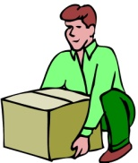
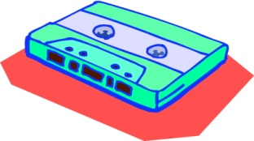



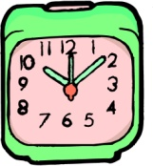

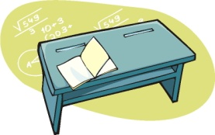
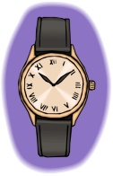


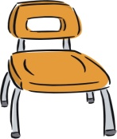
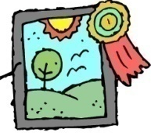


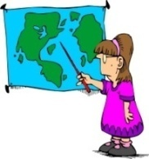







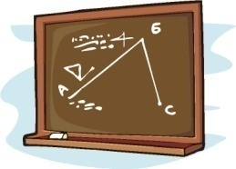
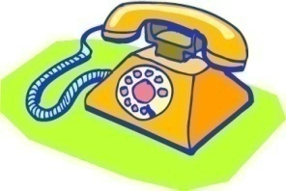

VOCABULARY
1 | 8 | 15 | 22
2 | 9 | 16 | 23
3 | 10 | 17 | 24
4 | 11 | 18 | 25
5 | 12 | 19 | 26
6 | 13 | 20 | 27
7 | 14 | 21 | 28

Slide 3

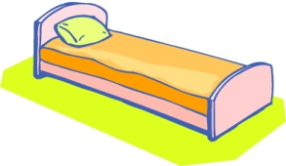


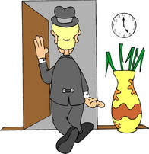

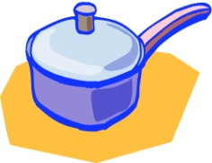
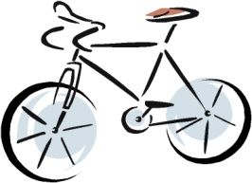
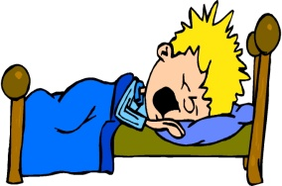


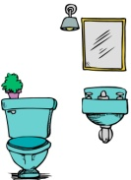


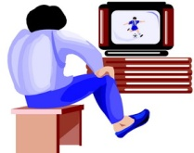

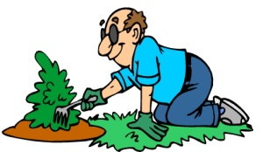
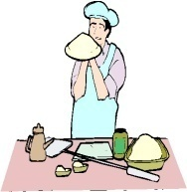

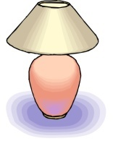
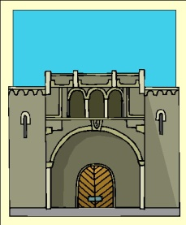


VOCABULARY
1 | 8 | 15 | 22
2 | 9 | 16 | 23
3 | 10 | 17 | 24
4 | 11 | 18 | 25
5 | 12 | 19 | 26
6 | 13 | 20 | 27
7 | 14 | 21 | 28

Slide 4

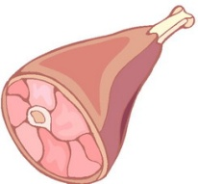


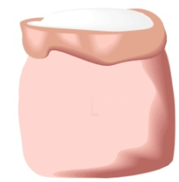










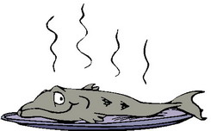



VOCABULARY
1 | 6 | 11 | 16 | 21
2 | 7 | 12 | 17 | 22
3 | 8 | 13 | 18 | 23
4 | 9 | 14 | 19 | 24
5 | 10 | 15 | 20 | 25

Slide 5







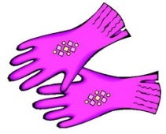




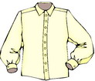


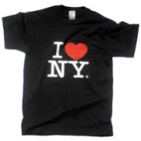

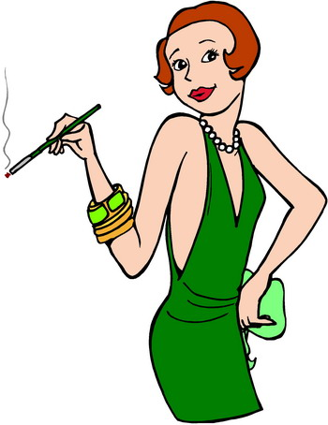
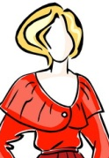



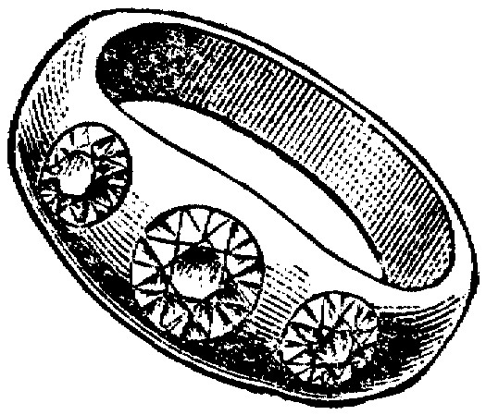
VOCABULARY
1 | 8 | 15 | 22
2 | 9 | 16 | 23
3 | 10 | 17 | 24
4 | 11 | 18 | 25
5 | 12 | 19 | 26
6 | 13 | 20 | 27
7 | 14 | 21 | 28

Slide 6
GRAMMAR – ARTICLES
Fill in the blank with an article A, AN, THE if neccessary.
I need ...... eraser.
I like ...... car overthere.
Please look at …… board!
I want to buy …… ruler.
Open …… book, please!
I have to buy …… book and 2 homework books.
I love ...... flowers very much.
I love ...... flowers in my garden.
Do you have to clean …… living room every day?
Do you eat …… cakes and drink …… coffee?

Slide 7
GRAMMAR – SINGULAR AND PLURAL NOUNS
Change the following singular nouns into their plural forms
a dish
a cooker
a baby
an address
a match
a life
a bird
a nanny
an echo
dishes
cookers
babies
addresses
matches
lives
birds
nannies
echoes
a brush
a mouse
a lady
a bus
a toy
a wolf
a video
a box
a tooth
brushes
mice
ladies
buses
toys
wolves
videos
boxes
teeth

Slide 8
MODEL FORMING
QUESTION MODEL 1.1
DO YOU WANT A CAR?
YES, I WANT A CAR.
NO, I DON’T WANT A CAR.

Slide 9
QUICK REACTION PRACTICE
Want | a car | a house | money
Need | a pencil | an eraser | a ruler
Like | music | sports | movies
Hate | fish | beef | pork
Love | flowers | animals | beer
Have | a drum | a piano | a guitar
Wash | clothes | ties | shoes
Clean | the windows | the kitchen | the sofa
Carry | a book | a notebook | a knife
Sweep | the floor | the wall | the ceiling
Iron | jeans | T-shirts | gloves
Open | the gate | the door | the windows
Close | the shop | the curtains | the door
Cook | breakfast | lunch | dinner
Feed | the cat | the dog | the baby
Peel | potatoes | tomatoes | bananas
Keep | the bag | the money | the key
Mend | T-shirts | skirts | trousers
Brush | your teeth | your hair
Comb | your hair

Slide 10
HOMEWORK
NO HOMEWORK TODAY.

